Slide 1

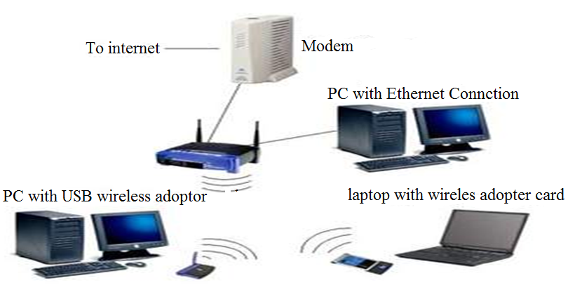
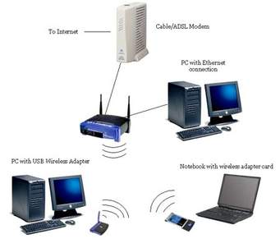
INTERNET & WORLDWIDE WEB

Slide 2
Content
Introduction to internet
    Meaning of internet
    Implications of internet
Internet services
    Internet communication services
    E mail services
    Netiquette
World Wide Web
    Web browsers c) Web sites
    Search engines d) Cloud computing

Slide 3
Introduction to internet
    a) Meaning of internet
Internet is the worldwide collection of interconnected networks that support communication and information exchange.
Internet can also be defined as the worldwide collection of networks linked together.

Slide 4
b) Implications of internet
Advantages of the internet
Allows faster communication by use of emails, face book etc
Provides education and online courses
Provides entertainment and leisure such as online games and music, magazines and vocation training guides.
Provides abundant information resource for easy research

Slide 5
Implications of internet…
Advantages of the internet
Provides online banking services and manages investments
Allows downloading of files, listening to music and watching sports.

Slide 6
Implications of internet…
Disadvantages of internet.
Promotes immorality
Spamming
Addiction
Pornography
Social isolation
Obesity
Malware threats

Slide 7
Internet services
    a) Internet communication services include;
        World Wide Web
        E-mail
        Video conferencing
        Internet telephony
        News groups
        Message boards
        Mailing list
        Chat rooms
        Instant massaging

Slide 8
Internet communication services…
The World Wide Web (WWW) or Web. This is the world wide collection of electronic documents (web pages)
E-mail: This is the transmission of a massage via a internet.
News groups / discussion group. This is an online area where users conduct online discussions about a particular subject.
Message boards: This is a web-based type of discussion group that does not require a newsreader program

Slide 9
Internet communication services…
Video conferencing. This is meeting between two or more geographically isolated people who use the internet to transmit audio and video data.
Mailing lists. This is a group of e-mail names & addresses given a single name. when a massage is sent to a mailing list, every person on the list will receive a copy of the massage.
Chat rooms. This is a location on the internet server that permits users to chat with each other by typing a line of text on the computer.

Slide 10
Internet communication services…
        Internet telephony (Voice over IP). This is a web based telephone service that allows a user to talk to others for just a cost of the internet connection.
        Instant massaging. This is a real time communication service that notifies a user when one or more people are online & then allows the user to exchange massages/ files with them.

Slide 11
Video conferencing

Slide 13
E-mail services
An e-mail is a message sent over a network.
Examples of popular email software include:
Microsoft outlook express
Endora
This is the standard that encodes email attachments into text form at the senders and then decodes them back to their original format at the receiver’s end is called MIME (Multipurpose Internet Expansion)

Slide 14
In order for one to send an email, he requires to have an email address. eg frankizza20@yahoo.com

Slide 15
Anatomy of the email address.
An email address consists of two parts i.e.
the username and the domain name. These are separated by “at” @ sign.
User name: this is the title of the individual or group of the individual operating the email account
The domain name: the domain name consists of the following parts;
Server: this the computer managing the email addresses. eg yahoo, EarthLink, hotbot. etc
Company nature that manages the email services e.g.

Slide 16
TLD Abbreviations | Type of Domain
.com | Commercial organizations, business & companies
.org | Non-profit organization
.net | Network providers
.edu | Educational institutions
.gov | Government agencies
.mil | Military organizations

Slide 17
Basics of sending and receiving an email.
To send and receive and email, one needs to have;
        An email account.
        Email software
An Email account is got either from the ISP or an online service provider like yahoo.
After acquiring the above, the online email/ service provider e.g. yahoo automatically creates you an e mail account interface which requires you to declare your user name and the pass word.

Slide 18
Features of an email account
After successful signing in, the email service provider automatically provides your account with features like:
    Inbox for incoming massages
    Outbox for outgoing massaged
    Address box for storing your personal email address etc

Slide 19
Sending emails
The service provider avails an option for the user to be able to create and send an email message. This is normally interfaced by tabs like “compose”, new etc.

Slide 20
Basic components of a sending window.
To: Holds the recipient’s email address
CC: (Carbon Copy). This sends a copy of email to other recipients & makes them aware that it was sent to others and even posts the sender’s address.
BCC: (Blind Carbon Copy): Sends a copy without telling the recipients that the same copy was sent to others.
Subject: this is where the sender enters the name/ title of the massage to be sent.

Slide 21
Basic components of a sending window.
Text area: This is the main area where the user enters/ types text to be sent as the main mail.
Attachment: This is the area that enables the user to link non textural documents eg photos, music, videos etc. to the email massage to be sent together.
Send: This is the tab that issues instructions to clients email software to post the massage

Slide 22
) Netiquette
This refers to the users guide to the polite way you use the web and emails on the internet and intranet.

Slide 23
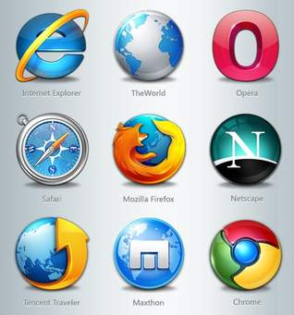

The World Wide Web
Web browsers
A web browser is an application software used to access and view web pages.

Slide 24
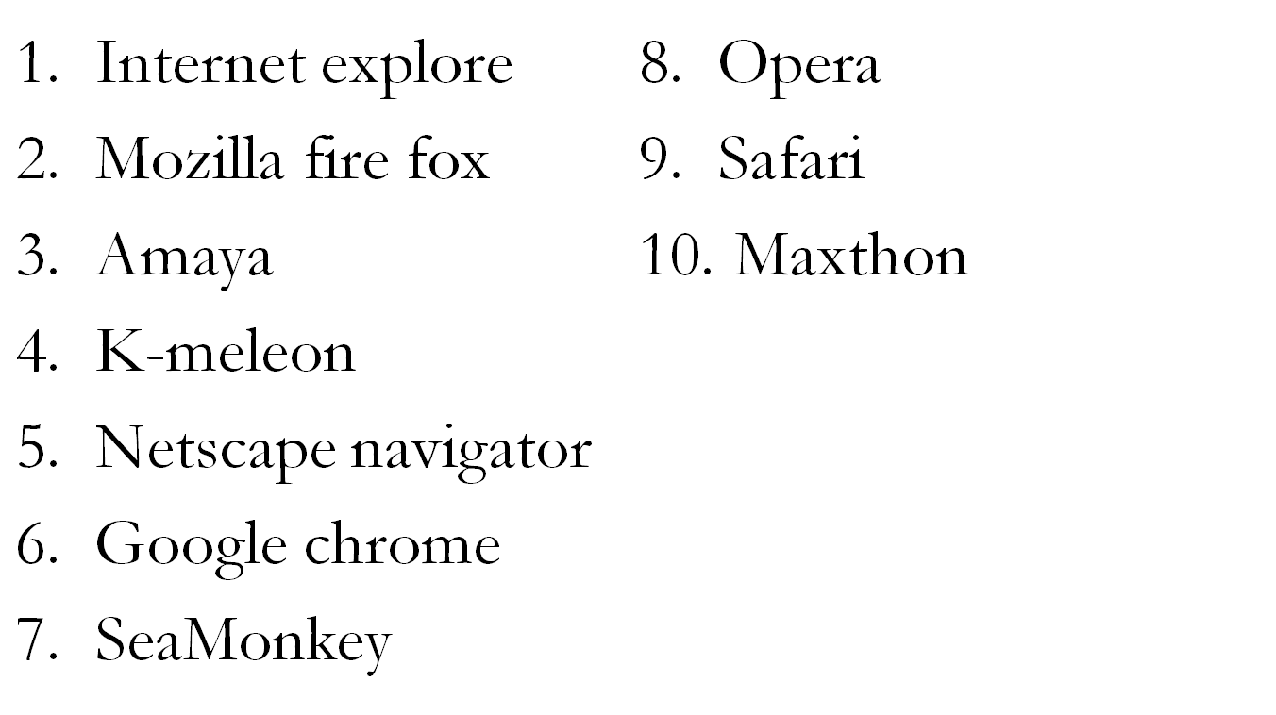
Examples of web browsers:

Slide 25
Search engines
A Search engine is a software program that can be used to find websites, web pages and files on the internet.
To find a website, a user just enters a word or a phrase called the keywords or search text.
Examples of search engines
Google
Hotbot
Lycos
Exite
Yahoo

Slide 26
Web sites
Types of websites.
Static websites
Dynamic websites
E-commerce websites or online shopping site
Personal websites
Blogs
Informative website
Entertainment portal,
social networks.

Slide 27
Static websites: these are often small websites which contain stationary information. They usually contain texts, images, simple navigation menus.
Dynamic websites: these are typically larger websites that is data base driven . They contain hundreds of web pages with huge amount of different content. Dynamic web pages get information from a data base and can be customized frequently and automatically according to the user’s specific needs.

Slide 28
E-commerce websites or online shopping site: These are a type of websites where you can purchase goods or services online. They are mainly built and designed to solve the users business needs and make money.
Personal website
These contain information about an individual or group of hobbies, interests, life, events and other personal thoughts photos etc.

Slide 29
Information websites: these are designed to deliver information in an educational way to teach users on various topics. They developed and designed in form of encyclopedias, online guides, article catalogues, information brochures etc. eg wekipedia.com and about.com
Entertainment portals, social networks: these are websites where people share idias, communicate, make and meet friends on line. Eg facebook
Entertainments portals are often large websites containing enatrtaiment news, online games, music, videos and different types of fun and exciting content.

Slide 30
social networking website.
This is a type of website where users can seek others who share their interests, find out what's going on in their areas of concern, and share information with one another.
Examples of social networking websites.
Facebook
Twitter
Google Plus, etc.

Slide 31
Disadvantage of social networking websites
They are addictive.
They are not regarded as formal
In case one forgets his/her password, signing in is not possible and this can lead to loss of information.
Social Networks may violate privacy in case someone else gets to know your user password.
Misinterpretation: One has to be careful while posting any kind of information on social networks. If typed in a hurry, the matter could be misinterpreted.
Junk Messages: Social Networks are used a lot to send unsolicited messages and unwanted advertisements.

Slide 32
Cloud computing
This is a service offered on the network by a collection of servers.
The practice of storing regularly used computer data on remote servers that can be accessed via the internet for easy update and retrieval.
These computers/cloud of computers enables the users visiting to have access to much faster servers, be able to access programs and services from any where within internet access often without having to install other software and get access to the services from any device capable of reaching the network or internet.

Slide 33
Examples of websites that offer cloud computing services.
Amazon web services (AWS)
Dashlane an online password service
Google app engine
Google docs
Online backup
Windows azure
Websites such as Facebook. Picasa & YouTube

Slide 34
Amazon web services (AWS) provides a variety of cloud computing services.
Dashlane is an online password service that manage passwords between all devices.
Google app engine a service that enable users to create scalable web services that use Google resources.
Google docs is a free solution from google that allows one to open microsoft doccuments as well as share them with other users within internet access.

Slide 35
Online backup is an online service that allows you to store your important information offsite. E.g. Mozy and Dropbox
Windows azure is Microsoft cloud computing service that allows companies to develop & run services from their cloud.
Websites such as Facebook. Picasa & YouTube

Slide 36
Relevance cloud computing
It provides free storage space.
It avails information where you are provided you have internet.
It safeguards your data from getting lost due to disk crash.
It provides a backup storage.
Reduces cost in terms of hardware requirements for storage.

